Slide 1
Steps to create and use FTP account on UTA cloud

Slide 2
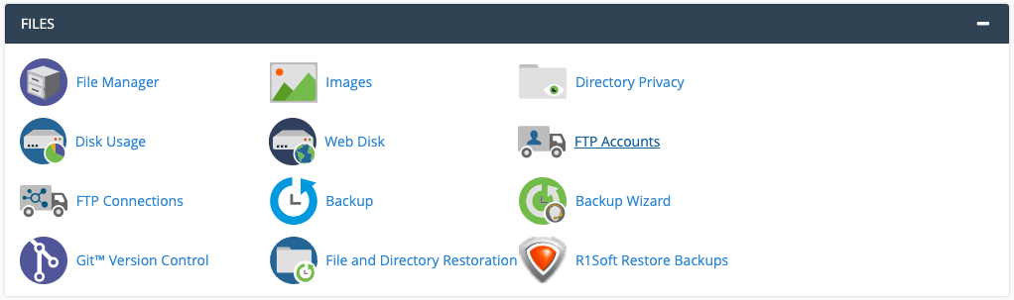
Login to UTA cloud and click on FTP accounts on dashboard

Slide 3
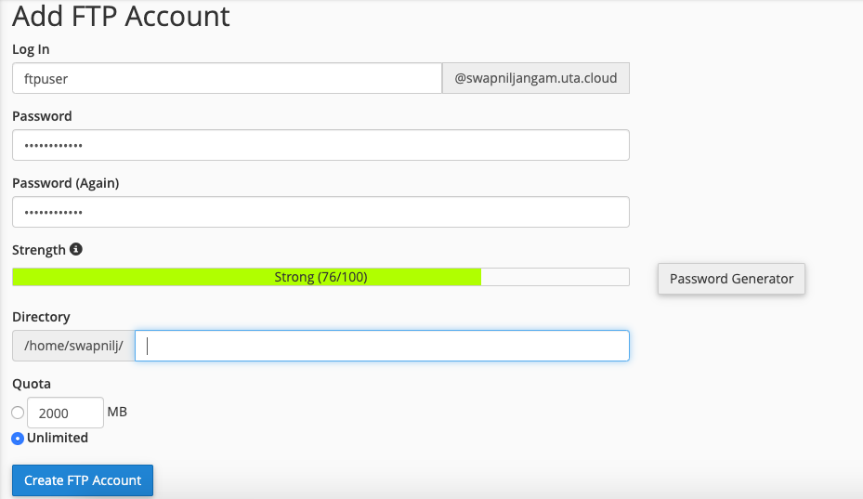
Fill login user and password Important: Make sure you keep the directory empty
Click on create FTP Account

Slide 4
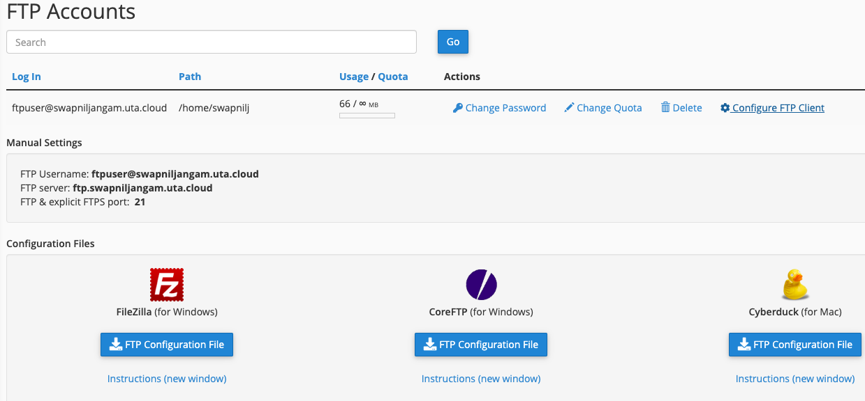
After account is created it should show up in FTP accounts page
Click on configure FTP client and download FTP configuration file for any of the softwares that you are going to use to connect to cloud’s FTP (Install the FTP clients beforehand)

Slide 5
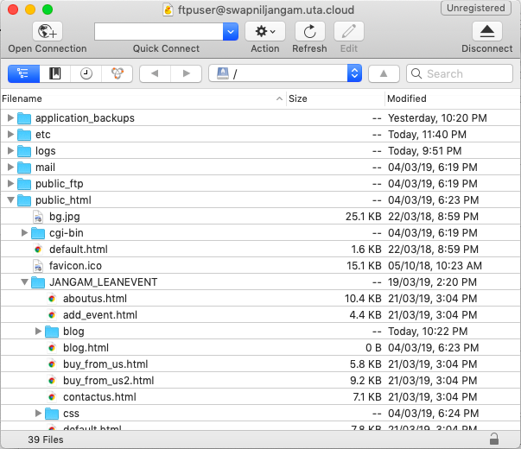
Open the downloaded file and it will connect you to cloud’s FTP
You can easily drag and drop folders into the window which will reflect in UTA cloud file manager

Slide 6
You can also use the manual settings to connect from slide 4 in case you are using WinSCP for windows

